Slide 1
MAND Policy Update & Telehealth Town Hall
November 8, 2023

Slide 2
POLICY UPDATE & TELEHEALTH TOWN HALL
Sangeeta Pradhan, MEd, RD, LDN, CDCES – MAND President
Frances Parpos, MPH, RD, LDN, CDCES – MAND Immediate Past President
Sarah Andrus – MS, RD, LDN – MAND President-elect
Maureen Gonsalves, MEd, RD – MAND Director of Operations
Sarah Conca, MPA, RDN, LDN – MAND Director of Public Policy
Ellen Lowre – RDN, LDN – MAND Nutrition Services Payment Specialist
Tom Mangan – Bulfinch Strategies
Jay Youmans – Bulfinch Strategies

Slide 3
POLICY UPDATE – NOVEMBER 2023
An Act Putting Patients First took effect in January 2021
Made permanent coverage and reimbursement parity for behavioral health services provided via all modalities of telehealth, including audio-only
Mandated coverage and reimbursement parity for primary care services and chronic disease management through December 2022
For all other services, insurers could reduce reimbursement rates 90 days from the end of the Massachusetts COVID-19 State of Emergency: September 2021
Since that time, certain insurers have elected to reduce reimbursement rates for telehealth services

Slide 4
POLICY UPDATE – NOVEMBER 2023
In 2022 MAND’s Board of Directors approved hiring a lobbying firm to advocate for coverage and reimbursement parity for MNT provided via all modalities of telehealth
Two bills were filed in the 2023-2024 legislative session
An Act relative to behavioral health and nutrition counseling (H.R.1072)
Introduced by Representative Meghan Kilcoyne (D-12th Worcester)
An Act relative to telehealth parity for nutrition counseling (S.618/H.R.1073)
Introduced by Senator Julian Cyr (D-Cape and Islands) and Representative Meghan Kilcoyne (D-12th Worcester)
Notes:
- Defense, health care, roads, schools, taxes to pay for everything!

Slide 5
POLICY UPDATE – NOVEMBER 2023
MAND’s bills were just two of thousands of bills filed in 2023
They were among 300+ bills referred to the Joint Committee of Financial Services – the first step in the legislative process
MAND presented live testimony before the Joint Committee of Financial Services in support of these bills in May 2023
MAND also submitted additional written testimony, data on MNT and a collection of patient testimonials submitted by MA dietitians, including many of you – thank you!
MAND is now connecting with key members of the state legislature to help the bill move through the multi-step process during the current two-year legislative session
Notes:
- Defense, health care, roads, schools, taxes to pay for everything!

Slide 6
POLICYMAKING 101
Public policy at the state level – 50 different approaches per the U.S. federal system
Public policy, or policymaking, is how the executive and legislative branches of government address public issues
Executive – Governor
Legislative – General Court, or “the legislature”
House of Representatives
Senate
Policymaking involves two parts
Advocacy – for or against particular policies and legislation
End result – policy, specifically laws and regulations
Notes:
- Defense, health care, roads, schools, taxes to pay for everything!

Slide 7
POLICYMAKING 101
Advocacy comes in two forms
Grassroots advocacy – Providing information on policy issues to individuals, helping them to contact their stat legislators to educate them on these policy issues and particular bills, such as our telehealth bills
This is what MAND is doing today!
Lobbying - Direct request to state legislators to support, advance or vote for particular policies or bills
This is what MAND’s lobbyists do!
Notes:
- Defense, health care, roads, schools, taxes to pay for everything!

Slide 8
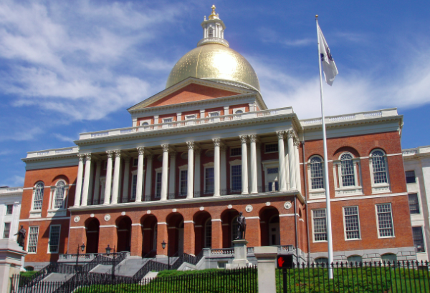
POLICYMAKING 101
Policymaking is complex
Begins in the legislature, at the State House, “Beacon Hill”
Notes:
- Defense, health care, roads, schools, taxes to pay for everything!

Slide 9
POLICYMAKING 101
Massachusetts legislature has 200 legislators
40 state senators
Serve two-year terms
Represent 159,000 people
160 representatives
Serve two-year terms
Represent 40,000 people in district
Every resident has one senator and one representative
Legislative sessions are two years long
Current session began January 4, 2023
Will run until January 7, 2025
Notes:
- Defense, health care, roads, schools, taxes to pay for everything!

Slide 10
POLICYMAKING 101
Once a bill becomes a law, a state agency is designated to create regulations to carry it out
Agencies draft regulations and solicit comments from people and organizations affected by the proposed regulations, then issue final regulations
MAND provides comments to state agencies when needed
Key state agencies in Massachusetts
Bureau of Health Professions Licensure: Licensing of dietitians – oversees activities of licensed dietitians
Division of Insurance: Reimbursement for telehealth services – oversees all insurance-related matters
Notes:
- Defense, health care, roads, schools, taxes to pay for everything!

Slide 11
MAND’S TELEHEALTH BILLS
What is the status of MAND’s telehealth bills?
Referred to the Joint Committee on Financial Services
Still “in committee” along with hundreds of other bills
What are our next steps?
MAND leadership and lobbyists are meeting with key legislators serving on other committees with jurisdiction over the legislative process, especially of health care legislation (e.g., Health Care Financial Committee, Ways and Means Committee)
What are other policymaking avenues?
The Division of Insurance could issue “final regulations” to clarify the language of the current telehealth law
What can you do to help us advocate?
You can learn who your state legislators are, what their key policy issues are, find opportunities to meet them, reach out to them
Notes:
- Defense, health care, roads, schools, taxes to pay for everything!

Slide 12
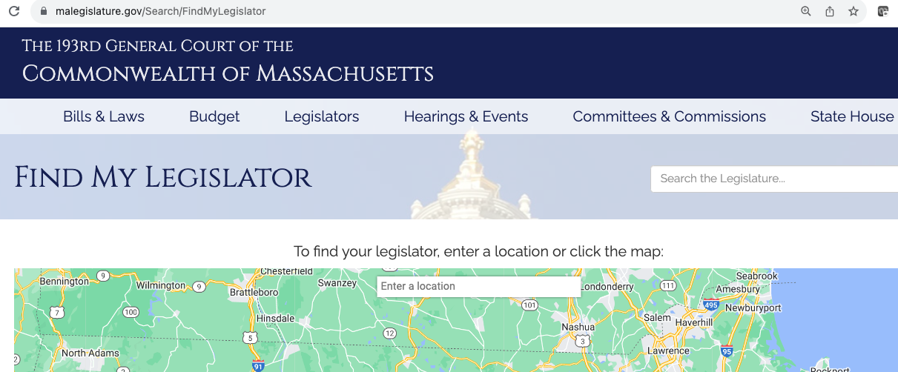
MORE INFO & RESOURCES
https://www.mass.gov/orgs/division-of-insurance
https://malegislature.gov/
https://malegislature.gov/Search/FindMyLegislator
https://malegislature.gov/Bills/193/H1072
https://malegislature.gov/Bills/193/H1073
https://malegislature.gov/Bills/193/S618
Notes:
- Defense, health care, roads, schools, taxes to pay for everything!

Slide 13
MAND wants to help you learn about the legislative process in MA so that we can advocate successfully for telehealth MNT.
Please visit MAND’s website to learn more https://www.eatrightma.org/page/telehealth-and-reimbursement-for-mnt

